Slide 1
STAR-IDAZ IRC Update
Maddy Newman
DISCONTOOLS PMB, 28 November 2022

Slide 2
IRC Objective and Deliverables
Objective: To coordinate research at international level to contribute to new and improved animal health strategies for at least 30 priority diseases/infections/issues
Deliverables:
Candidate vaccines
Diagnostics
Therapeutics
Other animal health products and procedures
Key scientific information/tools to support risk analysis and disease control

Slide 3
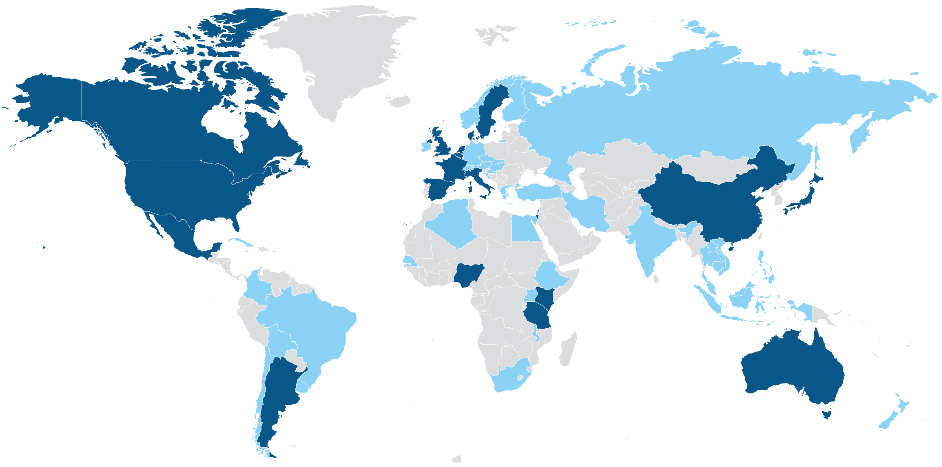

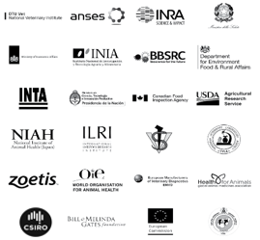

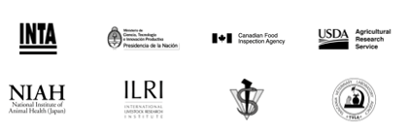





28
Partner
organisations
19
Member countries
50
Associated
countries
$2.5B
Research
investment

Slide 4





STAR-IDAZ IRC
Regional Networks
IRC Executive Committee
SIRCAH (Secretariat)
Scientific Committee
Working Groups
ASF
AMR and ATA
Animal genetics/genomics
Bovine Tuberculosis
Brucellosis
Coronaviruses
Diagnostics
Emerging Issues
FMD
Foresight
Helminths
Influenza
Mastitis
Mycoplasmas
One Health
PRRSV
Porcine Respiratory Disease Complex
Vaccinology
Vector transmission and control
?

Slide 5
SIRCAH2: Support for the International Research Consortium on Animal Health
HORIZON-CL6-2022-FARM2FORK-01-16: Support for international research on infectious animal diseases
SIRCAH2 start date: 1 October 2022
Length: 4.5 years
Partners: Kreavet (Coordinator), WOAH
Associated Partners: Defra, CABI, UKRI BBSRC
- Funding through the UKRI Horizon Europe Guarantee
Technical lead: Johannes Charlier

Slide 6
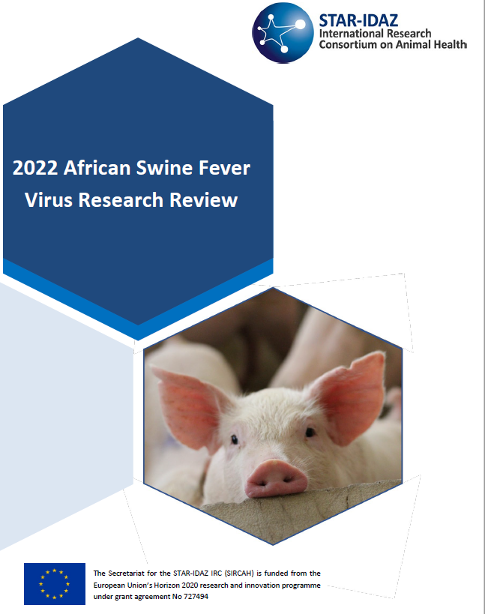
African Swine Fever
STAR-IDAZ IRC African Swine Fever Research Review published in April 2022
STAR-IDAZ supported the GARA Scientific Meeting
Dominican Republic on 24-26 May 2022
Review fed into scientific sessions
STAR-IDAZ IRC African Swine Fever Research Review published in April 2022
STAR-IDAZ supported the GARA Scientific Meeting
Dominican Republic on 24-26 May 2022
Review fed into scientific sessions
Day 1: Sessions on Epidemiology and Virology
Day 2: Sessions on Pathogenesis and Immunology
Day 3: Sessions on Diagnostics and Vaccines
Day 4: Supplementary Workshop: Regional
coordination
Next step: Update roadmaps

Slide 7
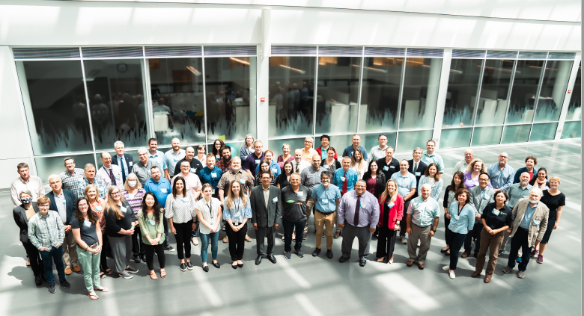
Influenza
IRC Influenza Research Review published in June 2021, with USDA ARS
Animal Influenza Gap Analysis and Countermeasures Assessment Workshop at NADC in Ames, Iowa, 14-15 June 2022
65 international experts and industry representatives
Plenary session followed by breakout sessions
  Knowledge gaps: Virology, Pathogenesis, Immunology, Epidemiology, Surveillance
  Gaps in available Countermeasures: Vaccines, Diagnostics, Outbreak response
  Zoonosis
  Obstacles to Prevention and Control
Next step: Develop roadmaps for vaccine, diagnostic and control strategies
Notes:
Next step

Slide 8
AMR and Alternatives to Antibiotics
To develop alternative to antibiotics and to reduce/rationalise the use of medically important antimicrobials in livestock as to safeguard their effectiveness, decreasing the level and the development of AMR in livestock, while maintaining/enhancing production levels, and controlling the occurrence of disease
Research gap focus:
Research needs to identify alternatives to antibiotics acting directly on the pathogen, including establishing their mode of action (focus on phages)
Research needs to identify agents/compounds for their ability to enhance the hosts resistance to disease, including establishing their mode of action (focus on immunomodulators)
Research needs to establishing how antibiotics work as growth promoters
Research needs relating to the role of the microbiome in maintenance of health

Slide 9
AMR & Alternatives to Antibiotics
STAR-IDAZ IRC Research Roadmap Development for Alternatives to Antibiotics report published September 2022, includes:
Summary of gap analysis activities
  3rd International Symposium on ATA in Thailand, December 2019
  STAR-IDAZ gap analysis workshops, October 2020
  STAR-IDAZ roadmap and market/regulatory challenges workshops, October 2021
Research Roadmaps on phage technologies, immunomodulators, and manipulation of the microbiome

Slide 10
Vaccinology
Applications of platform technologies in veterinary vaccinology and the benefits for one health
Gary Entrican (Roslin Institute) & Michael Francis (BioVacc), May 2022
The importance of the animal-human interface in the history of vaccinology.
Online tools for the design and development of veterinary vaccines.
Landmark discoveries in veterinary vaccinology.
Platform technologies for accelerating veterinary vaccine development.
The One Health benefits of controlling animal diseases.
Next steps: Workshop to identify knowledge gaps needing to be addressed to move these platforms forward
Involving experts and representatives from EVI, ZAPI, CEPI and IVVN

Slide 11

One Health
New One Health Collaborative Working Group with
Global Research Collaboration for Infectious Disease Preparedness
Objective of WG: To strengthen the global One Health approach by encouraging collaboration, communication, and coordination across the sectors responsible for addressing infectious diseases and other health concerns at the huma-animal-environment interface.
Outputs: Report on ongoing and planned research addressing knowledge gaps, Report on priority One Health research needs including recommendations for coordinated funding for through gap analysis
3 co-chairs representing animal, human and environmental
~25 members inc. experts, researchers, funders from all relevant sectors, existing One Health networks

Slide 12
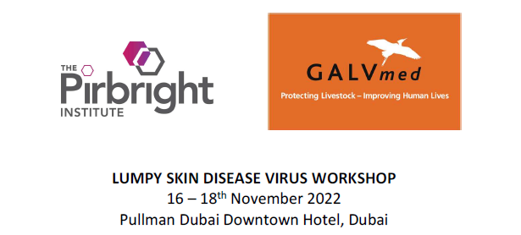
Lumpy Skin Disease
Scientific Sessions on Phylogenetics, Transmission, Epidemiology and Vaccinology
Session on Decision making and lessons learnt following LSDV incursions – a policy makers perspective
Next steps: Engage group to set up pox virus Working Group and develop roadmaps

Slide 13
Mycoplasmas and CBPP
Working with USDA ARS – funding award for CBPP
Commissioning review of recent research developments in Mycoplasmas
  Input from researchers in the field
  Similar to ASF and Influenza reviews
CBPP gap analysis workshop in London, 26-28th June
  Survey circulated before to guide discussions
  30 - 40 international experts and industry members

